Slide 1


UK Fares and NeTEx Profile – Knowledge Share
Online session 15th September 2020,
Nicholas Knowles

Slide 2

NeTEx & UK Standards
A Brief Overview
ROUTE

Slide 3







































Aggregating & Integrating
Data for Passenger Information
Maps
Networks
UK NeTEx
Bus Profile
Data Creation: Planning & Integration
☑
Data Integration & build
DJP
Timetables
SIRI-xx
Data Creation: Operations, Retail
User Applications
Fares
APIs
Engines
Dynamic Fares

Slide 4



What is NeTEx?
A CEN standard format for the exchange of PT data for Passenger Information
  Networks, Timetables, Fares
Based on CEN Transmodel conceptual model for PT data (NeTEx is a subset)
  Concepts evolved over 20 years from real PT systems across Europe. (Now on Version 6.0)
  Now mandated for widespread EU use
Uses a modular XML schema
  Model driven design from conceptual model in UML
  Free to use under a GPL License
ROUTE
Notes:
IF YOU HAVE SEEN SLIDES CIRCULATED IN ADVANCE

Slide 5








NeTEx is for bulk static data
(SIRI is for real-time data)
FSM etc
Retail API
Fare Products & Prices BASELINE PROVISIONING
Booking Systems
Formats
STATIC DATA
Trip Planning API
DJP
Timetables STATIC DATA BUILD
Trip Planner Engines
Realtime Operations
BASELINE PROVISIONING
Real-time API
Data must fit together via any route!
Real Time Feeds
Real-Time
Prediction Engines
SIRI-xx
Protocols

Slide 6





Integrating data from different sources to create PI services
Map API
Map
Engines
Map Tiles
Trip Planning API
Discovery DJP
Map Rending
Locations DJP
Maps – (GML, OSM, Inspire)
Trip Planner Engines
Trip Planner DJP
Infrastucture Features
Inspire
Trip Fares DJP
Timetable Data Build
Stop Events DJP
Discovery / Aggregation
Places – NeTEx Part1
Facilities DJP
POI – NeTEx Part1
Fare
Data Build
Other APIs……
Stops – NeTEx Part1
Protocols
Real-time API
Stop Times SIRI-ST/SM
Calendars – NeTEx Part1
Data Build for Real-time
Estimated Timetable SIRI-PT/ET
Operators – NetEx Part1
Timetables - NeTEx P2
Vehicle Monitoring SIRI-VM
Conversion
Real-time
Situation Store
Connections SIRI-CT/CM
Fares - NeTEx Part3
Real-Time
Prediction Engines
Incidents SIRI-SX
Formats
Facility Monitoring SIRI-FM
Other formats
Real-time feeds
Transmodel European Conceptual Model

Slide 7



Transmodel and the EC ACT/ ITS MMTIS Regulation
NATIONAL ACCESS POINT
data exchange
formats
INSPIRE
IATA
NeTEx
TAP
TSI
DATEX II
SIRI
spatial network
rail
air
road transport
multimodal: road, rail, water, air
urban & long distance transport
  Phased requirement to make data available
  EC investing in PT standards support

Slide 8








NeTEx – Evolution from National Standards
2000
2011
2012
2016
2018
Transmodel
v1.0- v5.1
Transmodel
v6.0
Transmodel
v6.0 (P1, P2, P3)
Transmodel
v6.0 (P4, P5, P6)
Transmodel
v6.0 (P7,P8)
Legacy .fr
Trident/
NEPTUNE
CEN
NeTEx
v1.1
CEN
NeTEx
v1.0
Part1
CEN
NeTEx
v1.0
Part2
Legacy .de
VDV452
CEN
NeTEx
v1.0
Part3
Legacy .uk
TransXChange,
etc
Legacy .nl
Bison, Noptis,
etc
NaPTAN,
etc
IFOPT
FareXChange,
TAP TSI
(Rail fares)
NeTEx
EU
PROFILE
Time
tables
.de profile
SIRI
NeTEx
EU
PROFILE
Fares
.fr profile
UIC
leaflets
.nl profile
.no profile
GTFS,
Notes:
NOT INVENTED OVERNIGHT – WOULD BE ALARMING IN A COMPLEX SUBJECT AREA
WE USED back in 2001 to bring NAPTAN & TXC togetehr
Used forto develop REAL TOME SERVICES
THOUGHT TO DIFFUCULT

Slide 9




NeTEx – and UK National Standards
2000
2011
2016
2017
2018
Transmodel
v1.0- v5.1
Transmodel
v6.0 (P1, P2, P3)
Transmodel
v6.0 (P4, P5, P6)
Transmodel
v6.0 (P7,P8)
CEN NeTEx v1.0
Part1 Core +Stops
CEN NeTEx v1.1
Part1 Core + Stops
CEN NeTEx v1.0
Part2 Timetables
CEN NeTEx v1.1
Part2 Timetables
CEN NeTEx v1.0
Part3 Fares
CEN NeTEx v1.1
Part3 Fares
EU Nx PROFILE
Timetables
EU Nx PROFILE
Fares
NaPTAN 1.o
csv
NPTG
v2.1
NPTG,
v2.4
NPTG
v2.5
UK Nx PROFILE
Basic Timetable
CIF .uk
NaPTAN
v2.1
NAPTAN
v2.4
NAPTAN
v2.5
\
TransXChange
v2.1
UK Nx PROFILE
Full Timetable
TXC
v2.4
TXC
v2.5
TXC Publisher
TXC Publisher
UK Nx PROFILE
Fares
UK NeTEx
Publisher??
FareXChange,

Slide 10
What is a NeTEx
Profile?

Slide 11


Public Transport data -
Functional Activity vs Time of Travel
PASSENGER INFORMATION
Pre-trip
planning
On trip, real-time
Historic & Query Stats
FARE MANAGEMENT
Offers
Sales,
Validation & Control
Historic Transaction
Settlement
TRANSPORTATION
Network, Scheduling
Vehicle monitoring & control
Historic Operation
INFRASTRUCTURE
Asset & Fleet Management
Preparation, Movement, Signalling, etc
Historic
Usage
Transmodel
Functional Area
Planning
Operations
History
Before
During
After

Slide 12
Standards Scope
Transmodel subdomains
GTFS-RT
PASSENGER INFORMATION
On trip, real-time
Historic & Query Stats
DJP
Pre-trip
planning
GTFS
FARE MANAGEMENT
Offers
Sales,
Validation & Control
Historic Transaction
Settlement
TRANSPORTATION
Network, Scheduling
Vehicle monitoring & control
Historic Operation
SIRI-xx
OPRA
INFRASTRUCTURE
Asset & Fleet Management
Preparation, Movement, Signalling, etc
Historic
Usage
Transmodel
Functional Area
Planning
Operations
History
Before
During
After

Slide 13
Simplifying implementation
Aspects of a NeTEx Profile
Profile - Scope?
  Relevant subset of NeTEx data elements for specific local business requirements.
  Mapping of legacy data elements to NeTEx.
Profile - Local Technical Details?
  Use of identifiers & codespaces (NPTG, NaPTAN, NOC).
  Use of coordinate systems (O/S, WGS85..), Time zones, etc..
  Grouping of elements in document
Profile - Use in National Context
  Granularity of NeTEx data files
  Participants & Workflow of data exchange
  Validation & Verification processes
Profile Management
  Stakeholders engaged in profile revision process
  Governance of processes for future evolution
13

Slide 14
Scope of Profiles
POI & Accessibility
data Profile
Stop & Timetable
PI Profile
Validation & Control
data Profile
Fare Profile
Infrastructure
data Profile
Timing data Profile

Slide 15
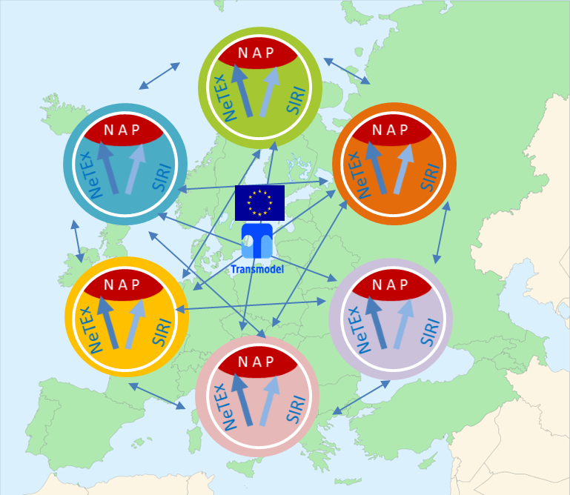
European Passenger Information Profile (EPIP)
Minimal profile for Basic Passenger Information
  Covers localities, stops and timetables
  Timetables are basic - Passing times only (no timings)
  No Fares
Intended for international and cross-regional exchange
  E.g. National Access Points can convert existing data
Shorter, implementation focused specification
  Includes validation rules and other implementation details
  Pan-European identifier system for frames & documents
Model for UK Base profile
  How to map a minimum set of UK timetable data
  Presentation Conventions also used Fare profile documentation

Slide 16
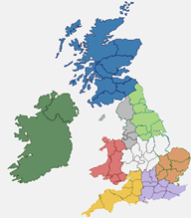
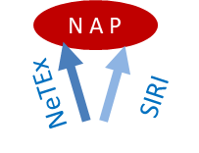
UK NeTEx Profile Project
Developwd a UK PI Profile that shows how UK Timetable data can be made available in NeTEx to conform to common EU Profile
  Subset of existing TransXChange capability
Develop a UK Fare Profile
  New UK standard for exchanging fares
  Focus on buses

Slide 17
Conformance to a Profile
Strict Conformance
  Use only the identifier codespaces, values, groupings, etc of the profile.
  Use only the XML elements, and attributes in the profile.
  A consumer system must interpret all elements and values.
Augmented conformance
  Use only the identifier codespaces, values, groupings, etc for the profile elements.
  Allow additional NeTEx XML attributes and elements to be present.
  A consumer system must interpret and consume all strict profile elements and values.
  A consumer system can ignore any augmented elements.
Extended conformance
  Use only the identifier codespaces, values, groupings, etc for the profile elements.
  Allow embedding of user defined extensions to NeTEx .
    Simple keylistt (value sets associated with elements),
    Embedded user schemas
  A consumer system must interpret and consume all strict profile elements and values.
  A consumer system can ignore any augmentations and extensions.

Slide 18
Degrees of Conformance
Any NeTEx XML element
Codespaces/
Identifiers,
Values,
Grouping
conventions,
etc
User Extensions
EXTENDED
NeTex Elements only
AUGMENTED +
Profile elements only
STRICT

Slide 19
EPIP vs UK Profiles - comparison
Codespaces/
Identifiers,
Values,
Grouping
conventions,
etc
AUGMENTED +
AUGMENTED +
EXTENDED
Strict (FXCP-1)
Augmented+
European Stop &
Timetable Profile (EPIP)
STRICT
UK Fare Profile s (FXCP-2)
STRICT
UK Basic profile extends EPIP

Slide 20



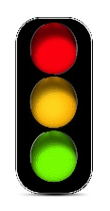








NeTEx Validators & Profiles
NeTEx
Profile
FareXChange
Profile
System A
System B
NeTE x ML
SCHEMA
?
?
PLACES
PLACES
STOPS
FareXChange
Validator
STOPS
☑
NeTEx
Validator
ACCESSIBILITY
ACCESSIBILITY
OPERATORS
OPERATORS
XML
Validator
ROUTES
ROUTES
Pass Fail,
TIMETABLES
TIMETABLES
FARES
FARES
FARE PRICES
FARE PRICES
FXCP
Fail, Warning, Pass
20
Notes:
WAY of getting COMPLEX INTERLOCKING TRANSPORT DATA FROM ONE SYSTEM TO ANOTHER
COMPLEX, IT COMES FROM MANY
PROFILE, partly because large and your business requriements

Slide 21
NeTEx
Resources
1. NeTEx
2. Fare Profile

Slide 22

NeTEx & Transmodel
CEN Specifications Documents
2. UK Basic Profile
3. UK Fare Profile
NeTEx EPIP Profile
NeTEx
Part1
Common Framework &
Network definition
NeTEx
Part2
Timetables
etc
NeTEx
Part2
Fares
etc
Transmodel
Part1
Common
Framework
Transmodel
Part2
Network definition
Transmodel
Part3
Timetables
Transmodel
Part4
Operations
& Control
Transmodel
Part5
Fares & Validation
TM 6,7,8

Slide 23






MODEL DRIVEN DESIGN
Concept
Conceptual Model is implementation independent
  Use to design
  Described in UML
  May have alternative Physical Models for different target implementations
  XML Physical design as UML
  Implementation is derived from physical model.
  NeTEx XML Schema
CONCEPTUAL MODEL
Design
Physical Model for HLL
Physical Model for DDL
Physical Model for XML
Implementation
in Java
Implementation in SQL
DDL
Implementation in XML

Slide 24
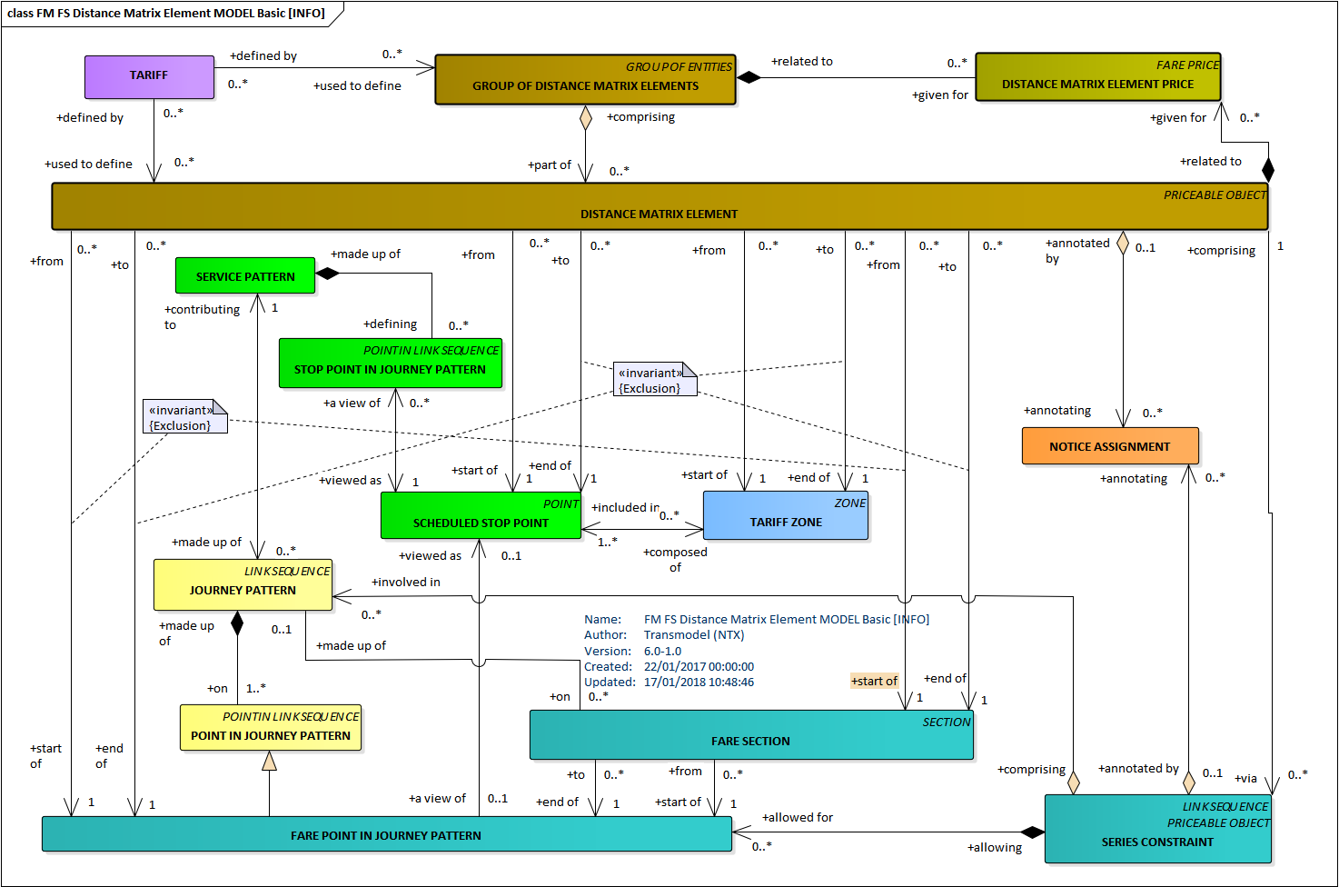
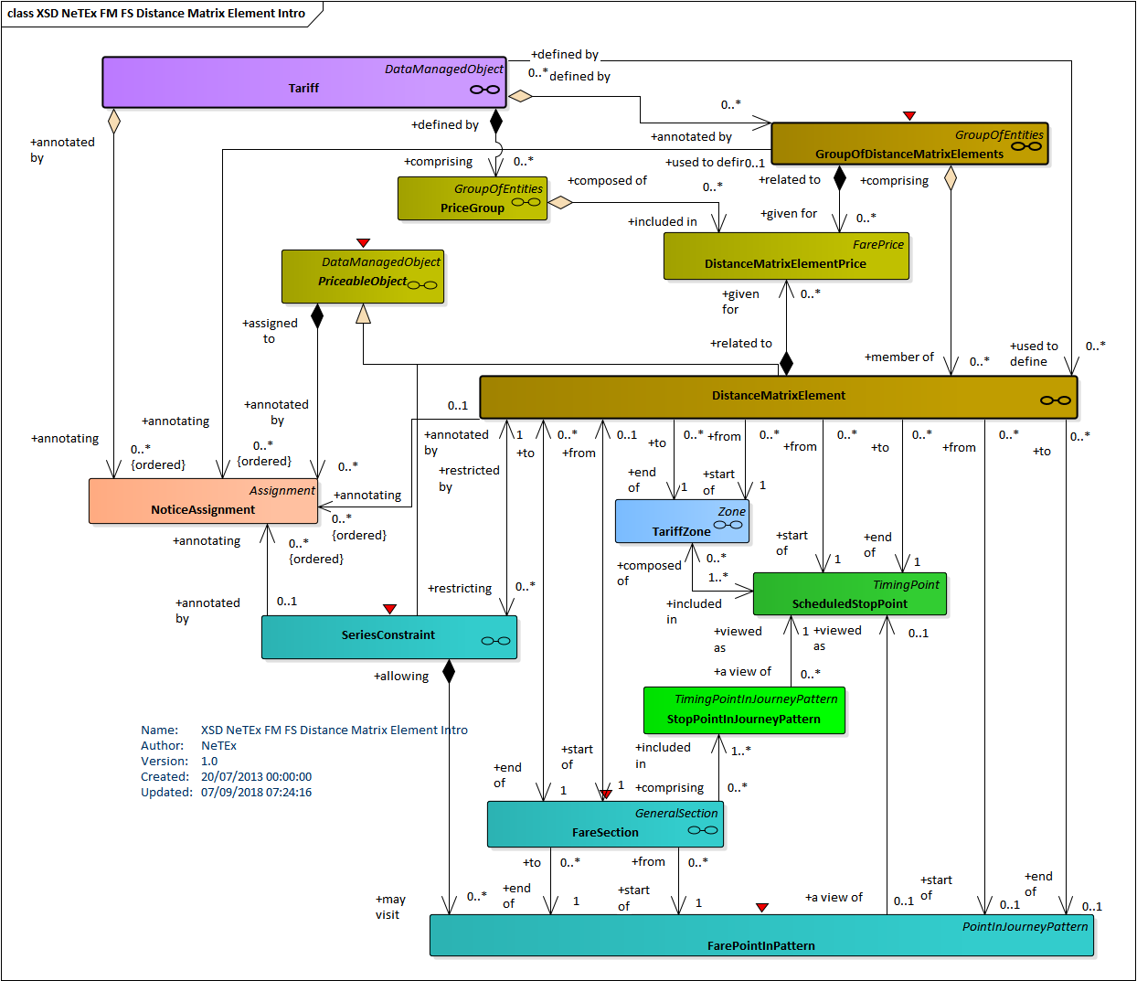
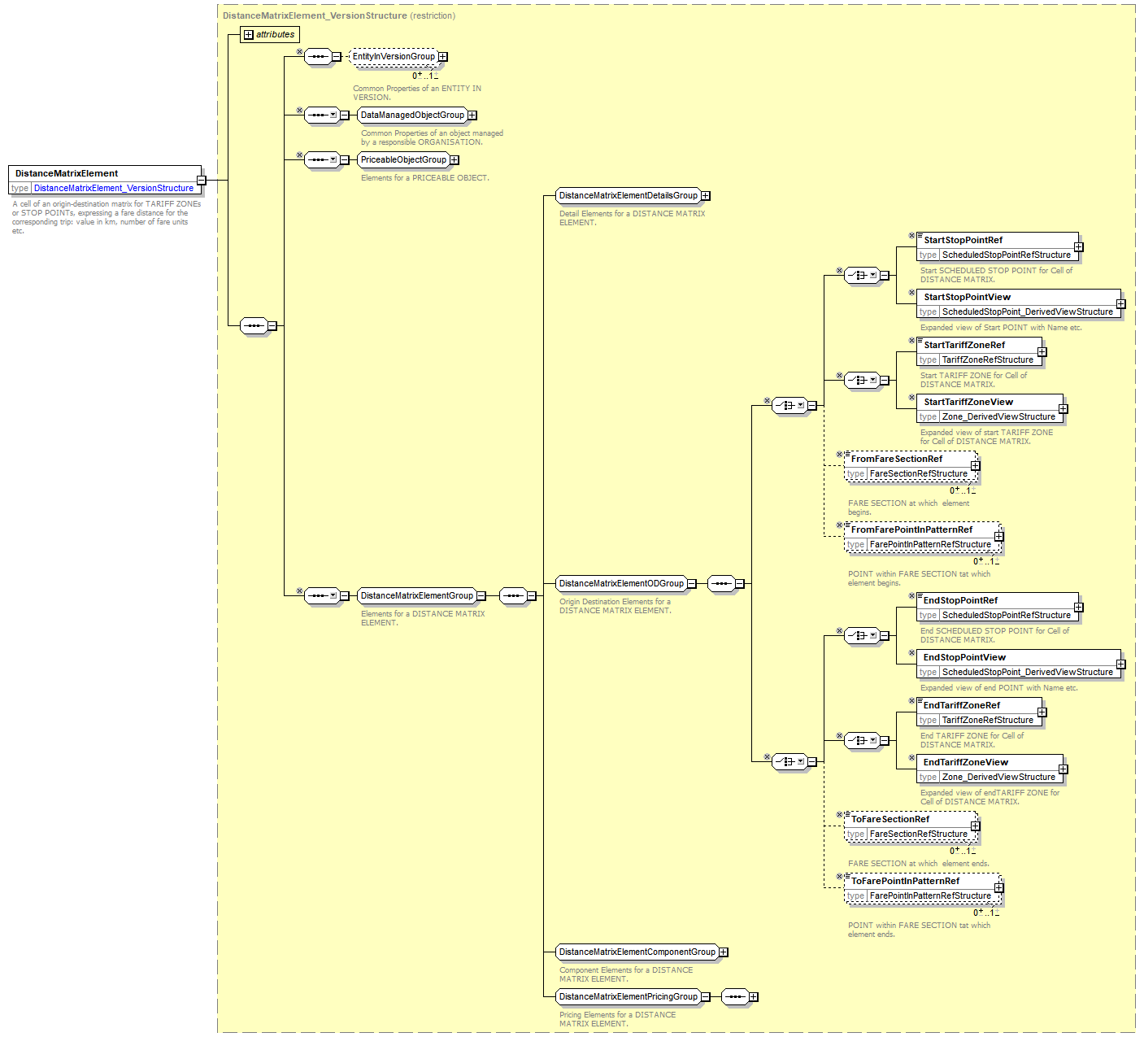

Designing a CEN Exchange format -
Package & Element level traceability
Conceptual
Physical
Schema
  Traceability
  Equivalent elements can be found at each level
  Physical design and Implementation each add further detail and constraints
  Tool support (EA, XML SPY, OXYGEN, etc)

Slide 25





  NeTEx Deliverables & IPR
  CEN specification documents (Modular)
    P1: Network, P2: Timetables, P3: Fares
    Available from BSI £ Buy, Copyright CEN
  UML Models (Modular). £ Free, GPL
    Conceptual, Physical
  NeTEx XML schema (Modular). £ Free, GPL
    Uniform grouping & versioning mechanisms to support large scale integration
  XML Examples (Modular). £ Free, GPL
    By Topic and Subject
  Website, white papers. £ Free, GPL
    http://netex-cen.eu/
25
Notes:
25
WHAT do I GET, is the IPR secure
What does it cost?

Slide 26
  UK NeTEx Deliverables & IPR
  UK Profile(s) £ Free, GPL
    Basic Timetable,
    Basic Fares, Additional Fares
    Full Timetable,
  UML Models of UK Profile. £ Free, GPL
    Conceptual, Physical
  XML Examples (Modular). £ Free, GPL
    Fares
26
Notes:
26
WHAT do I GET, is the IPR secure
What does it cost?

Slide 27
NeTEx UK Profile Progress - Specification
Audience
FareXChange documentation | Audience | Contents | FXCP Status | EPIP Status | XML Examples
Part1 Introduction | Overview, +Technical Intro | NeTEx intro. Scope of profile, Rationale for scope. Examples of UK Bus fare products in scope. | Review Draft 5/2019
Part2 Framework, Stops & Timetable | Technical detail | Common profile elements. Basic Stop elements; Basic Timetable elements. Use of UK data sets & identifiers. Coding, validation and data quality rules. Mapping from NPTG, NaPTAN, TransXChange. Examples of using UK data. | Review Draft 5/2019 | Final Draft 4/2019 | Draft 5/2019
Part3 Fares | Technical detail | Basic model elements for UK Bus Fares. Advanced model elements for UK Bus Fares. Coding, Validation and data quality rules. Use of NaPTAN and NOC data XML Examples. Mapping to csv / spreadsheet | Review Draft 5/2019 | Future | Draft 5/2019

Slide 28
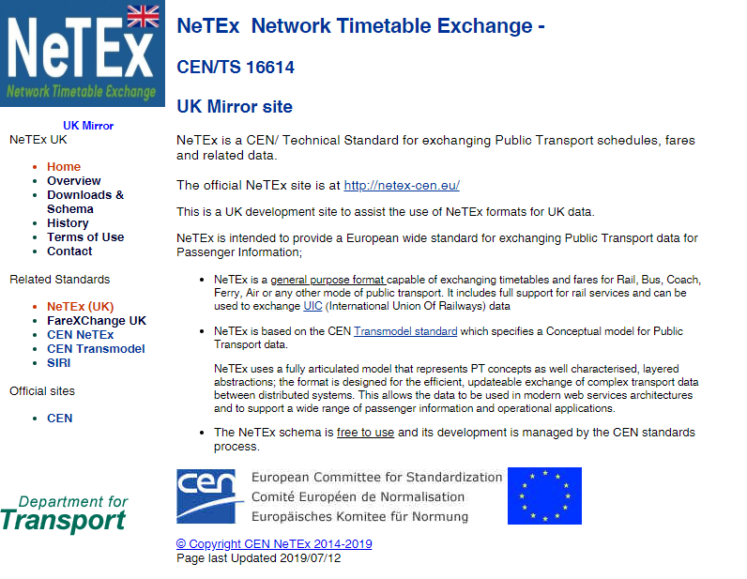
Netex.uk mirror site

Slide 29
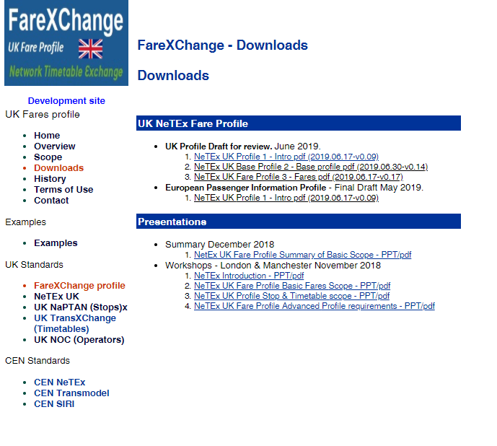
Resource -UK profile “FareXChange”

Slide 30



Scope of UK
NeTEx Bus Fare profile

Slide 31


Main UK use case is Fare & Price distribution – i.e. Downstream
Maps
NPTG, NaPTAN
NPTG, NaPTAN
TransXChange
Networks
UK NeTEx
Bus Profile
Data Creation: Planning & Integration
Data Integration & build
Timetables
Data Creation: Operations, Retail
User Applications
Fares
☑
APIs
Engines
Fares Build Tool
Dynamic Fares

Slide 32









#1.2: The Data Distribution Use Case
  Provide fare products & fare prices as open data for third party use (in journey planners, etc.)?
Describe available fare products and their eligibility conditions. ☑
Relate fare products to network and timetabled journeys so trip planners can compute fare products and fare prices for trips, show available products for area, etc. ☑
Allow the separate exchange of prices from fare structures & products. ☑
Expose a justification of the fare (Distance, discounts etc) ☑ Support both machine readable & human readable representation of validity parameters. ☑
Include information about how/where products can be bought. ☑
Include fares valid for specific and multiple operators. ☑

Slide 33



UK NeTEx profile: Aspects & Phasing
Aspect | UK Legacy | Basic UK profile | Advanced UK Fare Profile | Future / Further ?
Common Frame- work | (nptg, naptan txc) | Versioning & Validity Frames & grouping Identifiers & references | same
Localities | NPTG | Locations & Plus Bus Zones | same
Stops | NaPTAN | Stops , Tariff ones | same | Accessibility,? POI?
Timetables | TXC | Simple EU timetables (no timings, no op data) | n/a | Full TXC, Rail features?
Fares | new | Basic Bus Fares | More Complex Bus Fares | Long distance Fares?
Basic Profile
Advanced Profile
Out of current scope / For Future roadmap?

Slide 34









UK Profile scope - Modes
Can be covered by Basic Products
  Bus
  Bus as add-on to Rail etc (e.g. Plus bus)
  Ferry
  Light Rail, Tram?
Require additional Advanced Features
  Bus supplements to Rail (PlusBus)
  Metro / London Underground, PAYG, Capped fares)
Require additional complex features
  Coach? (Seat Reservations, luggage, Routing?….)
  Rail (routing, complex times of trave,, etc)

Slide 35
“What is the minimum set of products needed to describe all common UK bus fares?
”

Slide 36




Basic Product Types - terminology
Trip
The product gives the right to make a one-off journey
Pass
The product combines access rights to make repeated journeys within a time interval (Day, Week, Month etc)
Carnet
The product comprises a number of Trips or Passes sold as a bundle at a discount. They must be used within a given period.

Slide 37




Tariff Structures - Spatial aspects:
Flat – There is only one price for the fare or product regardless of distance.
Point-to-point, Zone–to-Zone. The fare gives the right to travel between two named stops. A discrete fare price can be given for each origin/destination pair.
  Usually the fare prices increase progressively with increasing distance travelled, but the increase is not necessarily a strict linear function (further may be cheaper, and individual O/D prices may be adjusted arbitrarily to optimize yields, traffic, competitive advantage, etc).
  Both Zone/Stage count and distance fares can be expressed as Z2Z/ P2P.
Named Zone(s): The fare gives the right to travel in one or more identified zones. A fare price can be given for any allowed combination of zones.
  If the zones are disjoint , then this is in effect “Zone to Zone” If the zones overlap or are nested then the topology is more complex,
Stage / Section count. The fare gives the right to travel a certain number of sections or “stages” regardless of which specific sections they are. There is a price per zone used. The resulting fare prices are inherently progressive.

Slide 38
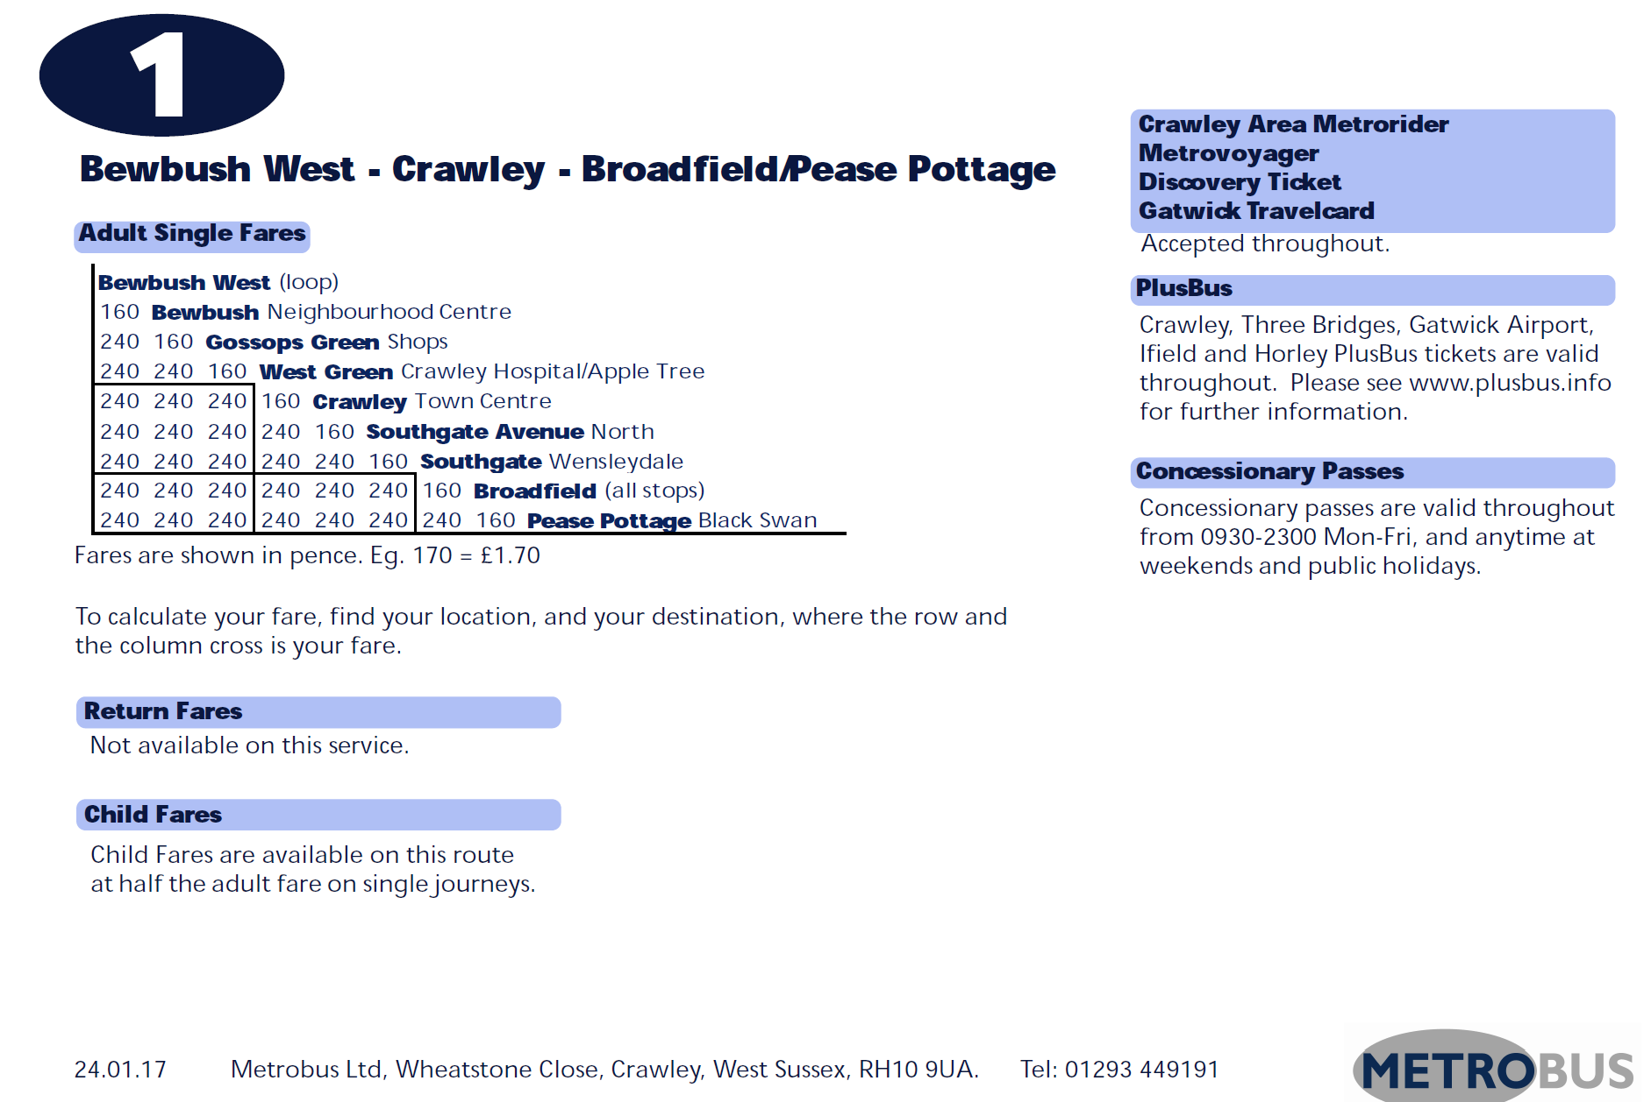
P2P / Z2Z Tariff Structure
© Metrobus 2018
https://www.metrobus.co.uk/route-information/1
Notes:
STICKING WITH OUR EXAMPLE
AN ELEGANT OIECE OF PASSENgeR INFORmATION FROM METROBUS
PAIR OF FARE TABLES
THAT ILLUSTRATE 80% of the common BUS FARE aASPECTS
KEY INPUT IS TO LOOK AT EXAMPLE

Slide 39
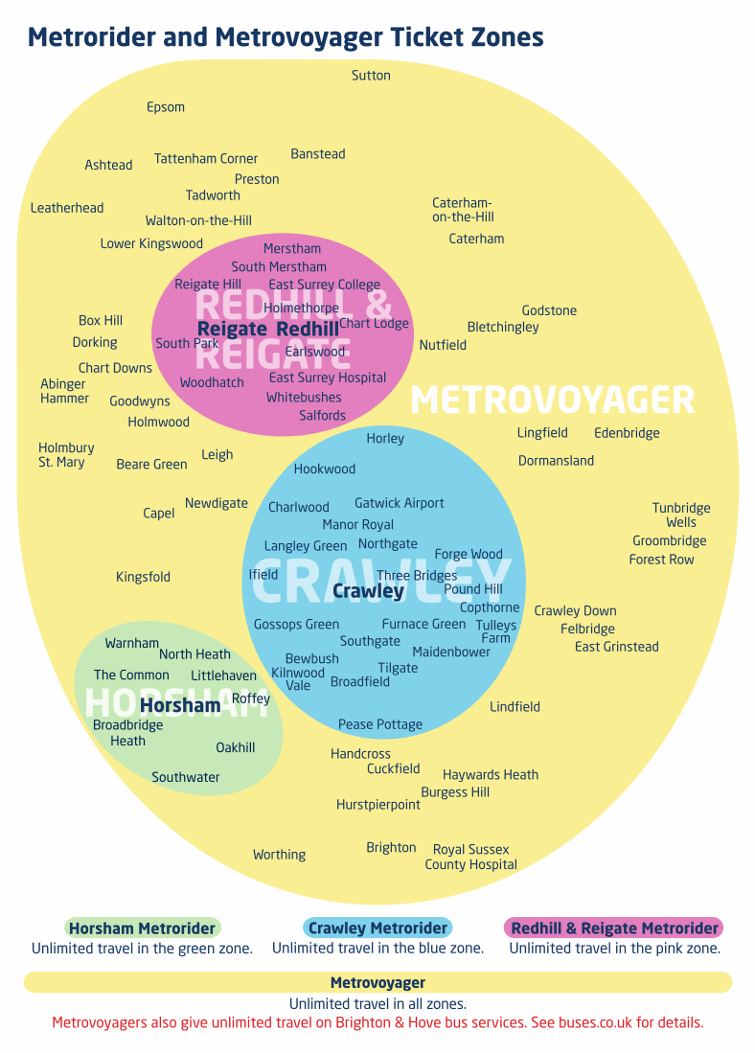

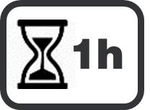








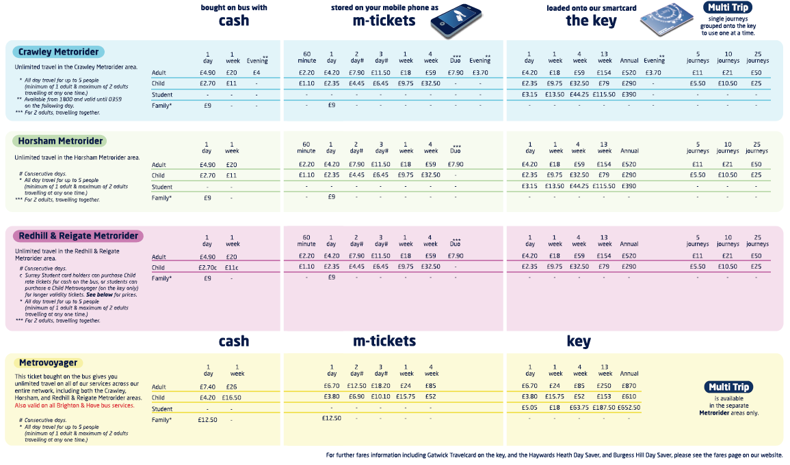



Zonal Pass with choice of durations –
TIME INTERVALs
FARE ZONE
FARE PRICE

Slide 40
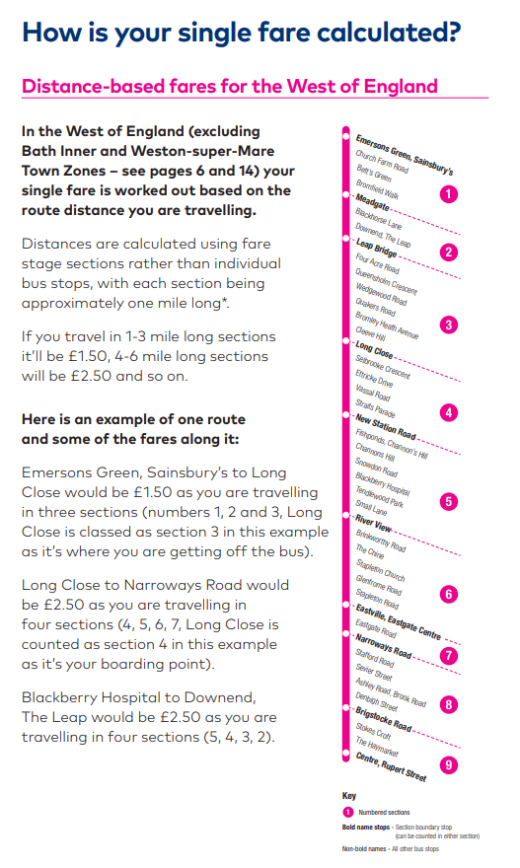

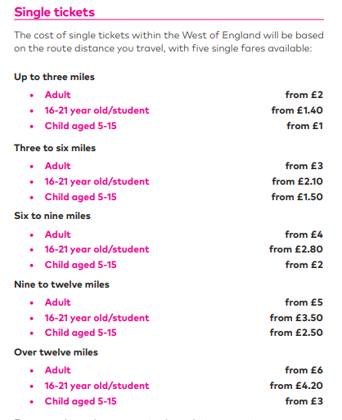
Stage /Section Count Fares
Does not matter which section, just the number of sections.
© First Group 2018

Slide 41






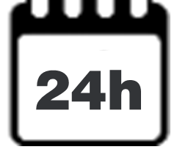






Basic UK Bus fare products
Access rights |  | Tariff Structure
Type of Product | Fare Product | Flat | Point to point | Named Zones | Zone/ Stage Count | Peak / Off Peak | Group Ticket | Temporal Conditions
TRIP (“single ride”) | Short hop | ☑ | ☑ | ☑ | ☑ | - | - | No journey break
 | Single trip | ☑ | ☑ | ☑ | ☑ | ☑ | ☑ | Has use by date?
 | Time-limited (“Hopper”) | - | - | ☑ | - | ☑ | ☑ | Max trip duration, Can interchange
 | Period Return | ☑ | ☑ | ☑ | ☑ | ☑ | ☑ | Has use by date?
 | Day return | ☑ | ☑ | ☑ | ☑ | ☑ | ☑ | Must use same day
PASS | Day pass | - | - | ☑ | - | ☑ | ☑ | 1Day(elapsed or calendar)
 | Termtime | - | ? | ☑ | - | - | - | Use during term 1Y
 | Season pass | ☑ | ☑ | ☑ | - | - | ☑ | n x D,W,M, 1Y
PREASSIGNED FARE PRODUCT

Slide 42
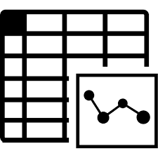



Carnets: Multi-trip / Multi-pass offers
Access rights |  | Tariff Structures
Type of Product | Fare Product | Quantity | Related tariff structure | Temporal Conditions
CARNET | Multi-trip | ☑ | Any individual Trip | Trips have use-by date Trips can be time limited
 | Multi-Day pass | ☑ | Day Pass | Passes have specified duration Passes have use-by date
FARE PRODUCT
(AMOUNT OF PRICE UNIT)

Slide 43
UK NeTEx Bus Fare
Profile
Advanced features

Slide 44



Some types of Complexity found of fares
Products supported by multiple operators
  Tariff structures covering large networks
    E.g. Plusbus
Compound products / offers:
  Multiple products in one package
    E.g. Oyster , Plusbus
  Products that are available both as separate offers and as single purchase
    E.g. Plusbus
  Local variation in rules & participation?
More complex Products & Tariff structures
  E.g. Capped Pay as You Go (Oyster)
Complex rules for a fare product, notably
  Day types / Timebands / Fare demand typs
    E.g. Metro & rail peak/offpeak into London
    Plusbus exceptions Night buses after 11.30
  Exclusions / inclusions of services
    E.g. all Metrobus in Crawley region except and line 4
  Eligibility conditions
Combining rules specified at different levels
  E.g. Temporal Validity conditions on tariff, product, sales offer

Slide 45
Peak and Offpeak – Fares
2020
SERVICE CALENDAR
E.g. Concessionary Pass product has use restrictions
X
…..etc c
2019
2018
X
…..etc c
Date →Day Type
2018/01/01 → DT-Holiday
2018/01/02 → DT-Weekday
2018/01/03 → DT-Weekday
2018/01/04 → DT-Weekend
…..etc
FARE DEMAND FACTOR
Peak: DT-Weekdays 0:00-09:30, 23:00-00:00
Off-Peak: DT-Weekdays 09:30-23:00, + DT-Weekend
DAY TYPE ASSIGNMENTs
2020
2019
2018
X
…..etc
X
…..etc
Fare Validity ,
2018/01/01;
00:00-24:00 Off-Peak
2018/01/02;
00:00-08:30 Off-Peak
08:30-09:30 Peak
09:30-17:00 Off-Peak
ETC, ETC
DAY TYPEs
TIMEBANDs

Slide 46
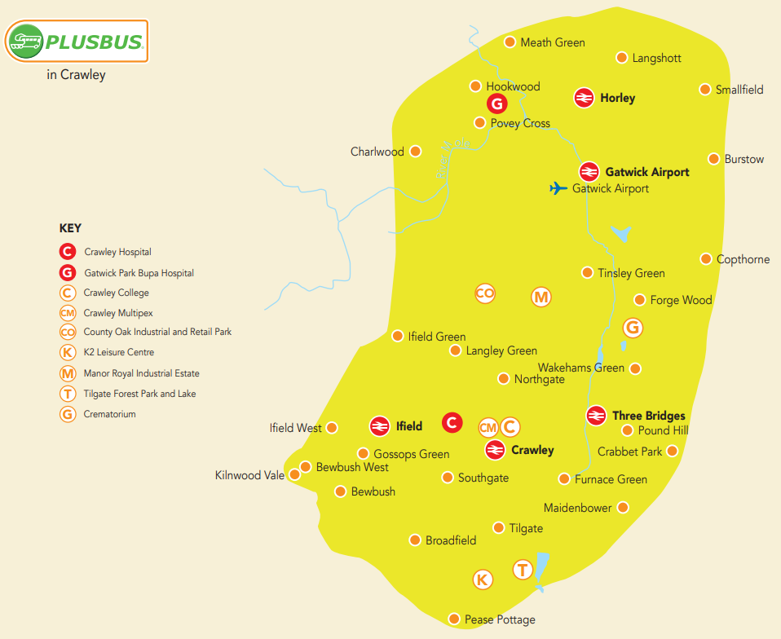


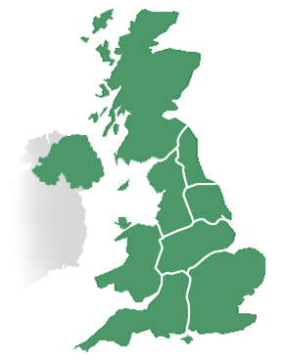
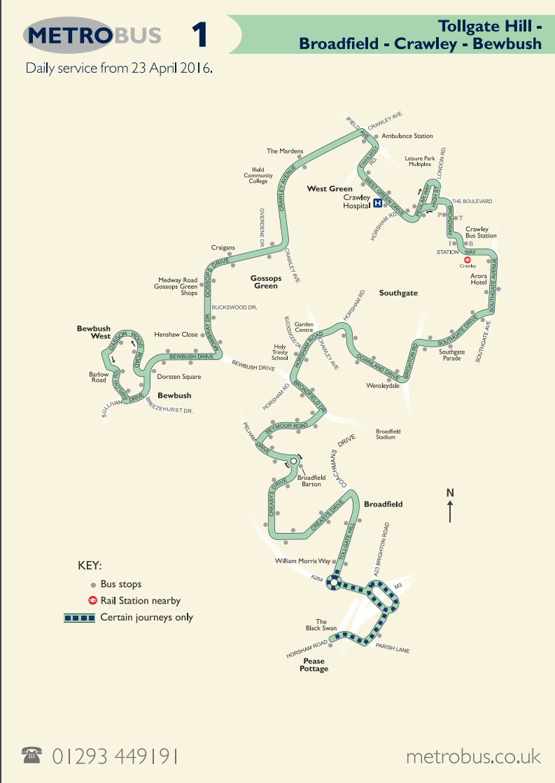
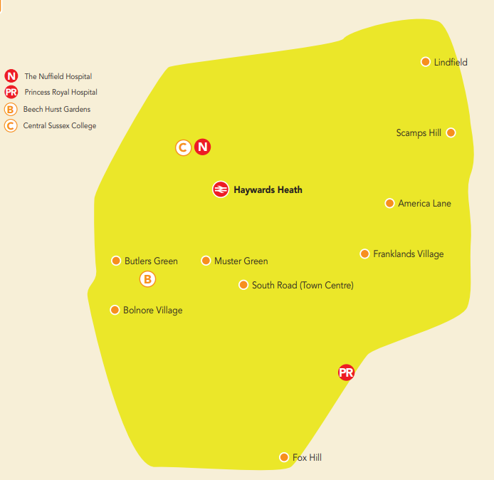
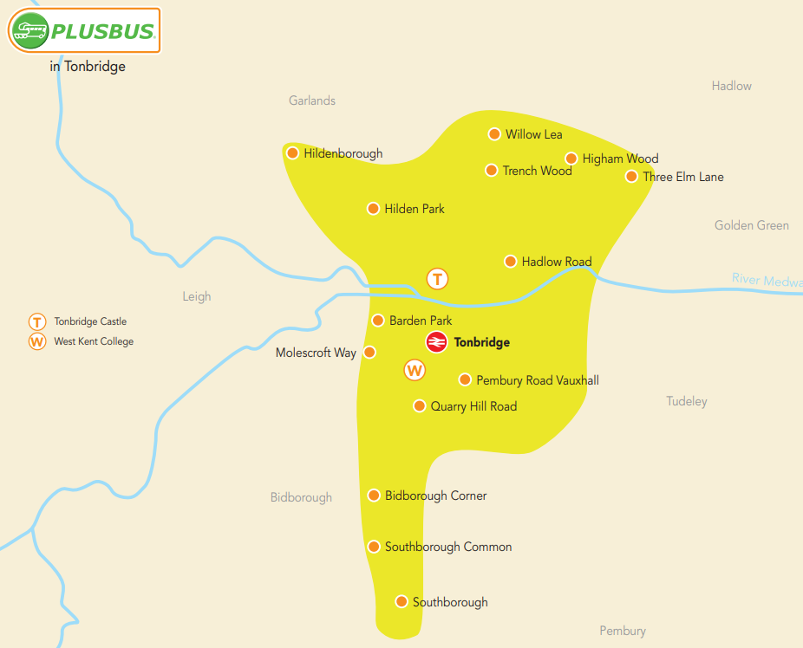
Interoperating fares – eg Plus Bus : Zonal add on for rail tickets
FARE ZONEs
TOPOGRAPHIC PLACEs
Zones around country
  Multiple participating Bus operators
  Exceptions in each zone
  Sold via rail sales channels

Slide 47





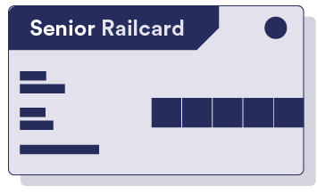

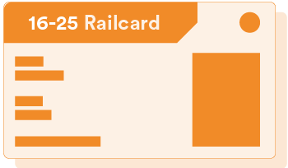
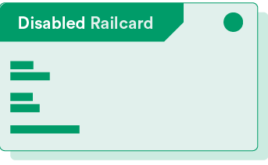



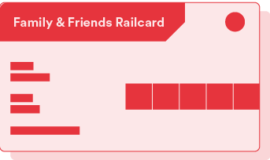
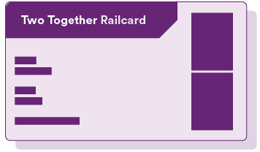



UK Rail card products
Single FARE PRODUCT
Multiple SALES OFFER PACKAGEs
  Different USER PROFILEs
Shared properties defined by GROUP OF SALES OFFER PACKAGES
Railcard GSOP
Flat rate
Railcard
Senior
Railcard
Disabled Persons Railcard
16-25 Railcard
FARE PRODUCT
Network
Railcard
Family & Friends Railcard
Two Together Railcard
USER PROFILEs
SALES OFFER PACKAGEs
47

Slide 48








Complex UK Bus Fare Products
Discount cards, etc
 | Fare Product | Peak / Off Peak | (Can) or Must be Account Based | Notes
SALES DISCOUNT |  | ☑ | ☑ | E.g. like a Railcard
 | Capped Sales Discount Right | ☑ | ☑ | PAYG e.g. Oyster
USAGE DISCOUNT | Usage Discount Right | ☑ | ☑ | Rebate for use, e.g. mileage
STORED VALUE | Amount Of Price Unit | - | ☑ | Stored value
ENTITLING PRODUCT | Third Party | - | - | E.g. Military Pass
FARE PRODUCT
SALES DISCOUNT RIGHT
CAPPED SALES DISCOUNT RIGHT
USAGE DISCOUNT
RIGHT
AMOUNT OF PRICE UNIT
THIRD PARTY PRODUCT

Slide 49




Additional Product Types - terminology
Discount Right
The product gives the right to purchase other fare products for travel at a discount, but is not itself a ticket. (e.g. Rail card, Oyster card).
Capped Discount Right
If there are multiple purchases, the purchase price is capped within a given time period (e.g. Oyster Card)
Usage Discount
The product gives a discount or rebate based on access rights consumed within a given period. Requires an account.
Amount Of Price Unit
The product holds an amount of stored value which can be used to purchase. May be linked to an account.

Slide 50










UK Fare profile: Basic vs Advanced Fare features.
Aspect |  | Basic Fare profile | Advanced Fare profile
Tariff Structure Spatial |  | Point-to-Point, Zone-to-Zone Zonal Stage fare / unit section Flat | Composite tariffs
Tariff - Temporal |  | Time intervals | + Peak/ off-peak etc conditions
Products |  | Trip, Pass, Carnet | +Sale Discounts, Capping
Product options |  | User Types, Group Tickets Simple travel constraints | +Complex travel constraints +Complex commercial conditions
Sales Offers |  | Media, Distribution Channel
Scaling |  | Line, Network, Operator(s) | +Complex Multi-operator, National, modular
Prices |  | Absolute prices | + Derived prices

Slide 51



Fare Prices
Prices are separate from the tariff elements they price.
  An element may have different prices with different validities.
  Prices may apply to individual elements or combination of priceable elements
Different type of prices
  Static / Base Prices
  Prices Derived from Base Prices
    Both amount and derivation
  Dynamic Prices (pricing service)
    Range bands for dynamic prices can be indicated by FARE QUOTA FACTORs

Slide 52



Pricing Dimensions
Pricing
User Profile
Purchase Window
Commercial Profile
etc
Group Ticket
Fare
Demand
Usage Parameter
Round Trip
Geographic Interval
Time Interval
Quality Factor
Distribution Channel
Routing
Sales Offer Package
Distribution Assignment
Series
Fulfilment Method
Fare Product
Structure Element
Access Right
Distance Matrix Element
Payment Method
Validity Parameter

Slide 53








Membership of Tariff Zones by Stops is explicit.
Network
Basis
Tariff Zone 1
Tariff
Zone 2
K
A
P
Q
J
R
SPATIAL PROJECTION
B
The model specifies which stops are in which tariff zone: a stop may be in more than one zone, zones maybe specific to an operator or shared.
Both stops and zones have a spatial projection. However spatial containment of a stop within a zone’s extent does not invariably imply semantic membership of the zone. In many cases the coordinates can be used to compute which stops are in a given tariff zone so as to populate the membership links.
A Tariff zone may also have presentation properties such as colour.

Slide 54
Fare Prices
Prices are separate from the tariff elements they price.
  An element may have different prices with different validities.
  Prices may apply to individual elements or combination of priceable elements
Different type of prices
  Static / Base Prices
  Prices Derived from Base Prices
    Both amount and derivation
  Dynamic Prices (pricing service)
    Range bands for dynamic prices can be indicated by FARE QUOTA FACTORs

Slide 55
Pricing Dimensions
Pricing
User Profile
Purchase Window
Commercial Profile
etc
Group Ticket
Fare
Demand
Usage Parameter
Round Trip
Geographic Interval
Time Interval
Quality Factor
Distribution Channel
Routing
Sales Offer Package
Distribution Assignment
Series
Fulfilment Method
Fare Product
Structure Element
Access Right
Distance Matrix Element
Payment Method
Validity Parameter

Slide 56









Price dimensions
Anything which is a price dimension for a UK Bus Fare needs to be represented by a model element in the profile
  E.g. O/Ds, zones, user types, channels, media types, etc
Anything else is optional –
  E.g. rules for ages of a use type such as child or senior
  E.g. Locations to buy tickets
Scope depends on specific tariff structures to be supported

Slide 57
Routes for which multiple Tariffs are applicable?
Products valid on Multiple Operators?

Slide 58

Each tariff describes itself; it is the trip planner/ fare engine’s task to find the applicable, best value fares for given trip
T1
G
Tariff 1
F
Tariff3
T2
B
A
Tariff2
D
T3
C
Tariff 4
T4
E
A→B: T1
A→C: T1,T2,T4
A→D: T2,T4
A→E: T4
A→F: T2
A→G: x
User Applications
Data Integration & build
APIs

Slide 59






PLUS BUS – National bus fare trip supplements
Available as
  Zonal day pass origin and destination stations
  Zonal Season pass origin and destination stations
Coverage
  City wide Tariff zones around stations,
  Named operators & Lines
  Local exceptions
Sales Packages / Distribution / Media
  Add-on purchased with rail ticket /season pass
  Bought separately to rail ticket or season pass
  As paper ticket, on smartcard some areas
Further discounts
  Rail cards for different User types
  Peak/Off-peak restrictions apply to railcard discounts
Product Owner: JSP: Branding?

Slide 60
Interoperating fares – eg Plus Bus : Zonal add on for rail tickets
FARE ZONEs
TOPOGRAPHIC PLACEs
Zones around country
  Multiple participating Bus operators
  Exceptions in each zone
  Sold via rail sales channels

Slide 61
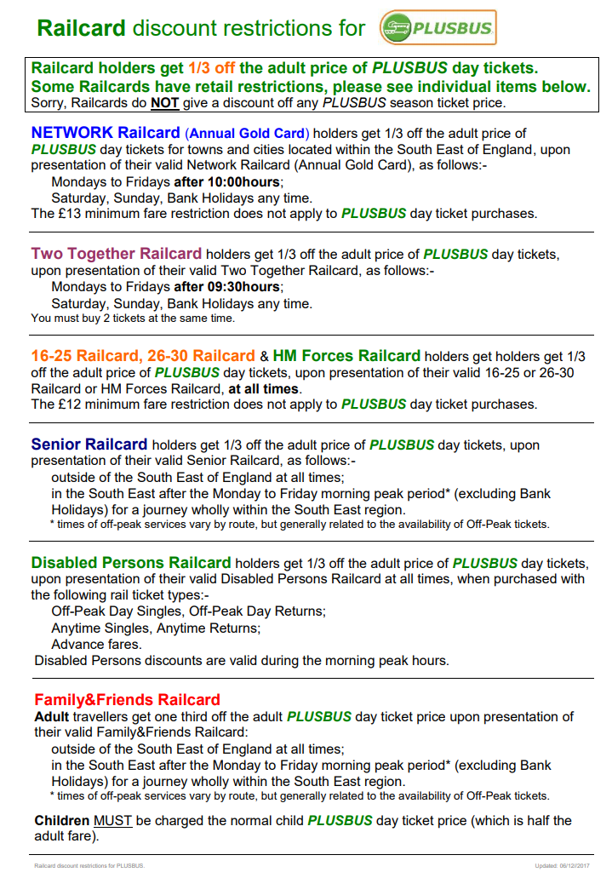



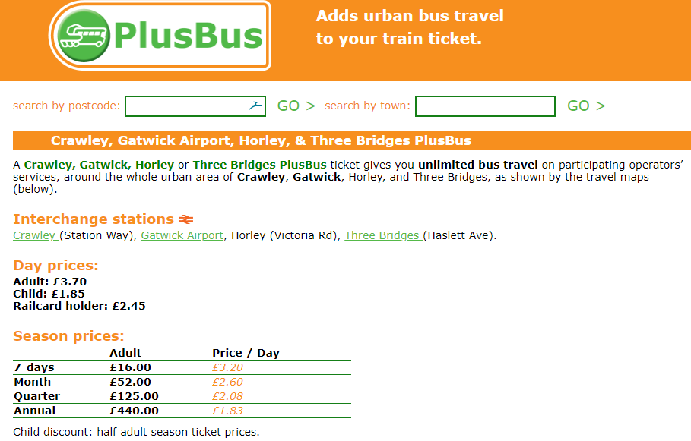

Plus Bus tariff - Crawley
DISCOUNT RIGHT
USER PROFILEs
SALES PACKAGEs
FARE ZONE
FARE PRODUCTs
TARIFFs
TIME INTERVALs
FARE PRICEs
USER PROFILEs

Slide 62


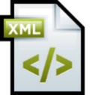


Modularise ; references may be internal or external
NeTEx XML documents

Slide 63



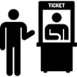




How to partition a Multi-operator product
Operator specific Lines & exceptions
Plusbus Prices
Operator B
Operator C
Operator …..
Plusbus Product definitions
Common Plus Bus definitions
National Stop & Plusbus Zone definitions
(NPTG & NAPTAN)
National Rail Travel Products
National Rail Railcard Products

Slide 64
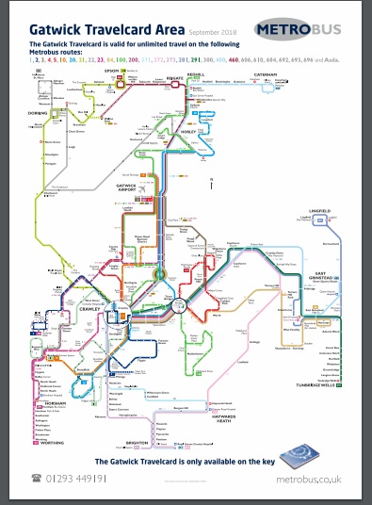
Multiple Tariffs applicable
Discovery Ticket, a one day travel ticket, allowing you to travel unlimited in West Sussex, East Sussex, Surrey, Brighton & Hove, East Hampshire, Kent and Medway on the following operated services:
Concessionary Pass Schema
© Metrobus 2018

Slide 65
Approach

Slide 66
Describing Fares with NeTEx
Network
Basis
  Network
    stops, tariff zones, line, operator
  Zone 1 contains 8 stops….,Line 1 runs…
Tariff
Structure
  Fare policy / tariff structure:
    space-, time-based…access rights
  P2p fare, Stage fare, Flat fare
Main title
Access
Rights
  Rights to access & consume services:
    scope and order of use
    validity and usage rules
  bus trip stop X to stop Y, metro trip 3 zones
Pricing
Content
Fare
Products
  Marketable combinations of access rights
    validity & usage limiting parameters
    & charging moments
  off peak metro trip 3 zones followed by bus trip 2 zones ,no interchange, Child reduction
Sales Offer
Packages
Prices attached to elements
Pricing rules
  Adult flexible single costs £30
  Child = 50% Adult price
  Sales Offer Description:
    media & travel document types
    distribution channels & contracts
  Paper ticket at ATM, carnet of 10, smartcard
Travel Specification
Fulfilment & Payment
Control & Validation
Billing &Clearing
  Travel Specification
    Specific set of choices to purchase
  Adult single A to B on a smartcard

Slide 67























































Describing Fares with NeTEx
Network
Basis
Common
Framework
Tariff
Structure
Access Rights
Fare Products
Pricing
Sales Offer
Packages
Travel
Specifications
& Sales
☑
☑
☑
☑
☑

Slide 68


Instances for a typical
Fare Product & Sales Offer
SALES OFFER PACKAGE
TARIFF
VALIDABLE ELEMENTs
(product)
FARE PRODUCTs
TARIFF
SALES OFFER PACKAGE
ELEMENTs
TARIFF
FARE STRUCTURE ELEMENTs
TARIFF
TARIFF
PARAMETER ASSIGNMENTs
(sales offer element)
PARAMETER ASSIGNMENTs
(validable element)
PARAMETER ASSIGNMENTs
(product)
TARIFF
PARAMETER ASSIGNMENTs
(fare structure)
TARIFF
TARIFF
DISTANCE MATRIX ELEMENTs
PARAMETER ASSIGNMENTs
(sales offer)
Scoping & Temporal Parameters
TIME INTERVALs
TARIFF ZONEs
OPERATORs
USER PROFILEs
DAY TYPEs
MODEs
Etcetera

Slide 69
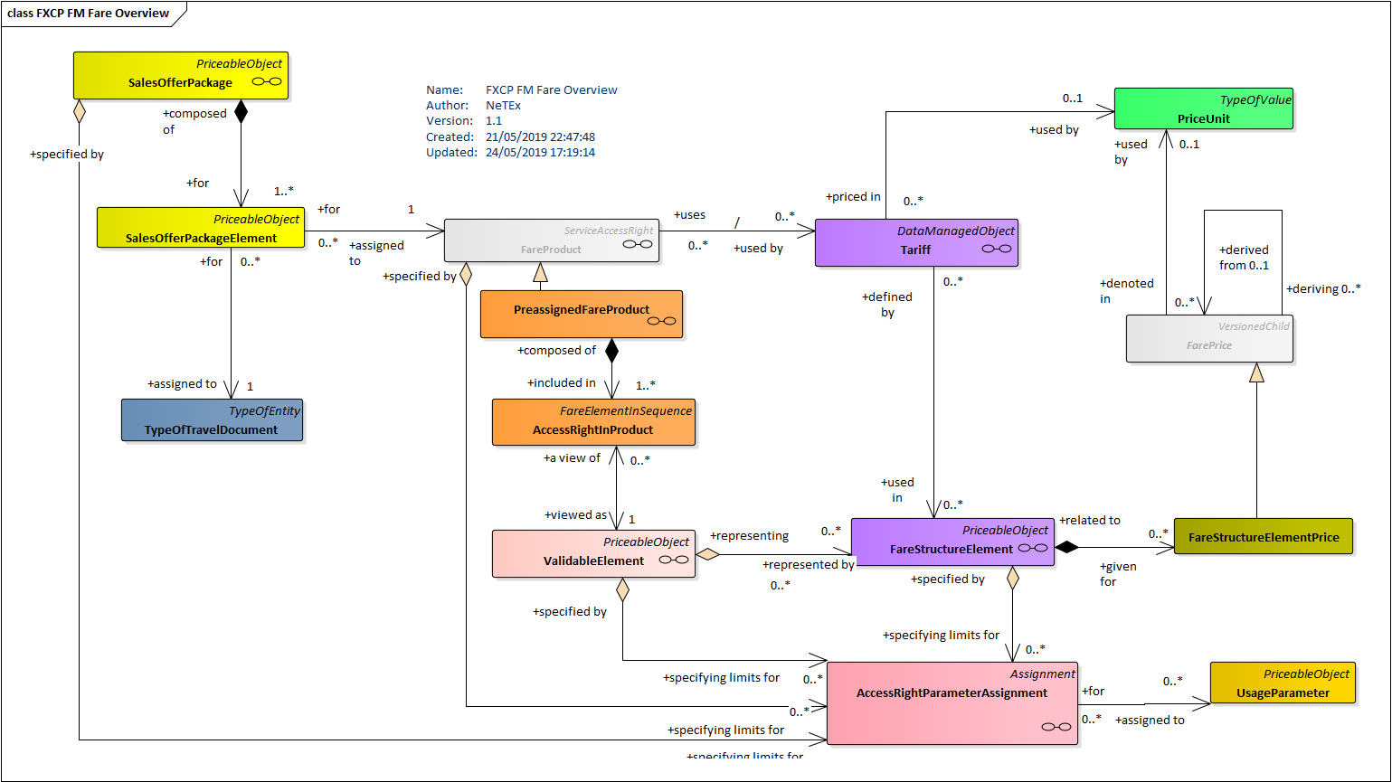
UK Fares – core UML Model

Slide 70
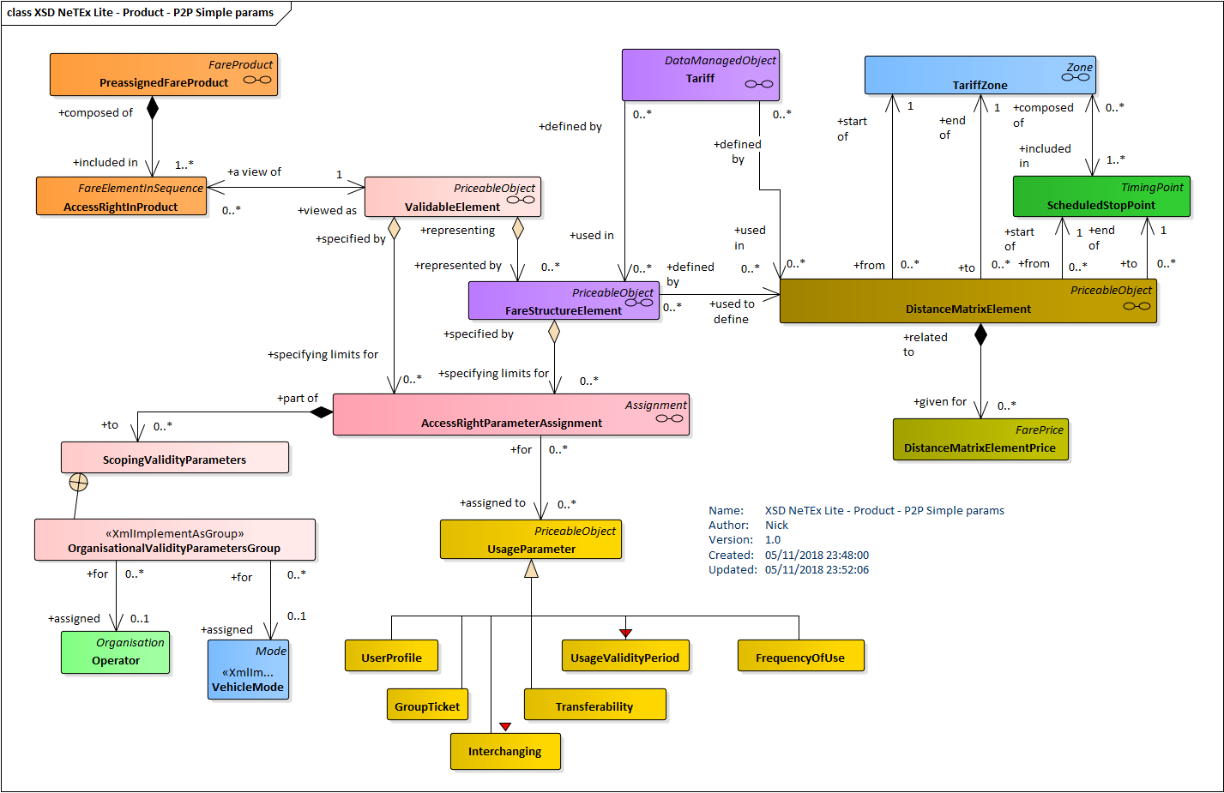
A Zone to Zone Product: Use DISTANCE MATRIX + Assign OPERATOR, MODE, USER PROFLEs, etc
USER PROFILE
DISTANCE MATRIX ELEMENT

Slide 71
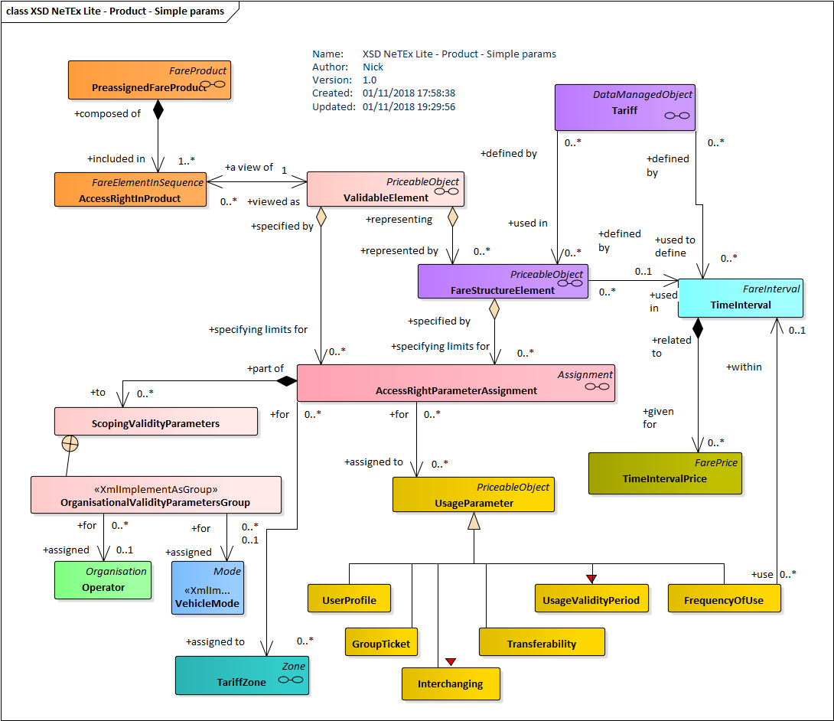



A Season Pass Product : Assign FARE ZONEs + OPERATOR, MODE, & USER PROFILEs

Slide 72
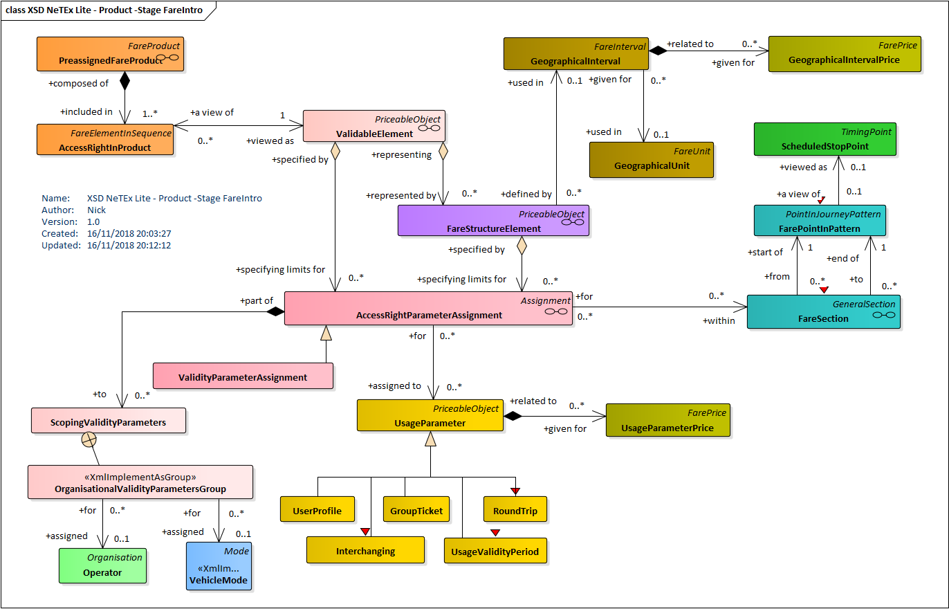
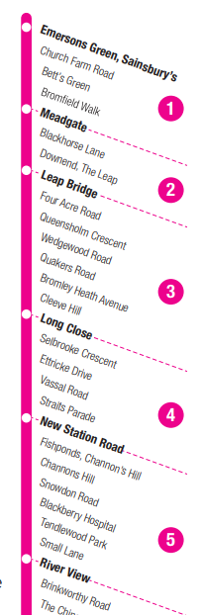
Modelling – Stage definitions
SCHEDULED STOP POINTs
FARE POINT IN PATTERN
4
Dynamic zone counting : Trip planner uses JOURNEY PATTERN to determine number of FARE SECTIONs traversed between origin and destination POINT IN PATTERN
FARE SECTIONs
© First Group 2018

Slide 73
Summary

Slide 74

Key Points: Fares are complex, but not that complex!
  We can represent any fare using a set of reusable components
    Tariffs can be related to the network using the concept of “Access Rights”
  For UK basic Bus fares there are four main Tariff Structures
    (a) P2P / Z2Z, (b) Zonal, (c) Stage / Section, (d) Flat
    We can model the elements of each of these on a single page of UML,
  For UK basic Bus fares there are two fundamental product groups
    (a) Trip, (b) Period Pass (Day, Week, Season etc)
  For UK basic Bus fares there are a limited number of other parameters needed,
    E.g. User Types, Group Tickets, Validity Periods, etc.
    E.g. Type of Travel Document, Distribution Channels, Payment Methods, etc
  To cover all UK Bus fares some additional products are needed
    (a) Amount of Price unit (b) Sale Discount right, (c) Capped Discount Right
74
UK NeTEx Timetable Profile

Slide 75
Describing Fares with NeTEx
Network
Basis
Common
Framework
Tariff
Structure
Access Rights
Fare Products
Pricing
Sales Offer
Packages
Travel
Specifications
& Sales
☑
☑
☑
☑
☑

Slide 76





















Component Based Fares
FARE PRODUCTs
SALES OFFER PACKAGEs
TRAVEL
SPECIFI-CATION
Network
TARIFF + FARE STRUCTURE ELEMENTs
Access Rights
FARE PRICEs
VALIDABLE ELEMENT

Slide 77
Instances for a typical
Fare Product & Sales Offer
SALES OFFER PACKAGE
TARIFF
VALIDABLE ELEMENTs
(product)
FARE PRODUCTs
TARIFF
SALES OFFER PACKAGE
ELEMENTs
TARIFF
FARE STRUCTURE ELEMENTs
TARIFF
TARIFF
PARAMETER ASSIGNMENTs
(sales offer element)
PARAMETER ASSIGNMENTs
(validable element)
PARAMETER ASSIGNMENTs
(product)
TARIFF
PARAMETER ASSIGNMENTs
(fare structure)
TARIFF
TARIFF
DISTANCE MATRIX ELEMENTs
PARAMETER ASSIGNMENTs
(sales offer)
Scoping & Temporal Parameters
TIME INTERVALs
TARIFF ZONEs
OPERATORs
USER PROFILEs
DAY TYPEs
MODEs
Etcetera

Slide 78
Some principles for Scoping UK bus tariffs
Every price dimension found in UK bus fares needs a corresponding model element
There is no single universal way to package fare offers
  Yet any type of product / offer can be built from a common set of components
You can exchange the data elements and parameters, but not how they are used
  E.g. pricing parameters (discounts, rounding)
  E.g. Combining conditions on tariffs, products and sales offers
Each product should just define its own tariff
  It is the trip planner / fare engine’s task to find all available tariffs

Slide 79



Benefits of Transmodel / NeTEx Approach to Fares
Powerful Component based representation
  Allows many different tariff combinations to be described with the same set of atomic components
  Allows complex conditions to be expressed
  Allows necessary packaging of products into different offers
  Gives highly reusable implementations
Joined up conceptual model - Reuses existing Network & Timetable elements
  Network (Stops, tariff zones, modes, operators, etc)
  Timetable elements, services etc
  Temporal conditions and day types, validities, same as for timetables etc
Robust, Flexible, Extensible Technology
  XML allows selective use, validation integrity checking etc
  UML provides tool supported system documentation
  Conceptual model for Account Based Ticketing and future developments

Slide 80
Some Drawbacks to a Component based Approach
Skills Investment needed to understand Concepts & Components
  Tariff structures, Access rights
  Uses of different parameters
  Product and Sales Offer packaging
Component based semantics require attention to assembly and compounding behaviour
  Exchange of data does not guarantee exchange of behaviour!

